Slide 1

السلام عليكم

Slide 2
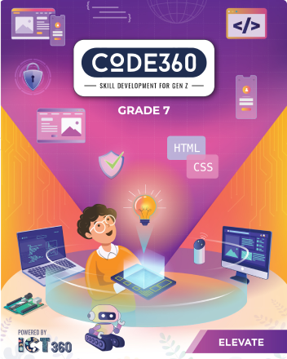
Mazen
Saad
Computer Teacher

Slide 3
ICT
Grade 7

Slide 4

Enter the notebook and write the following:

Slide 5

Lesson title
3D Environment
The Date
2025 / 9 /

Slide 6
1-A ball is an example of a sphere.
2- Plane geometry deals with flat shapes like lines, curve, polygons etc, which can be drawn on a piece of paper.
3- Blender allows used to create customised workspaces for different tasks like modeling animationg and scripting.
4- 3D viewpoint is used to interact with the 3D scene for a variety of purposes, like modeling, animationg, texture painting, etc.

Slide 7

Start

Slide 8
What We'll Learn Today
1
3D
2
Environment
3
Modeling
4
Rendering

Slide 9

Do you know what 3d environment is?

Slide 10
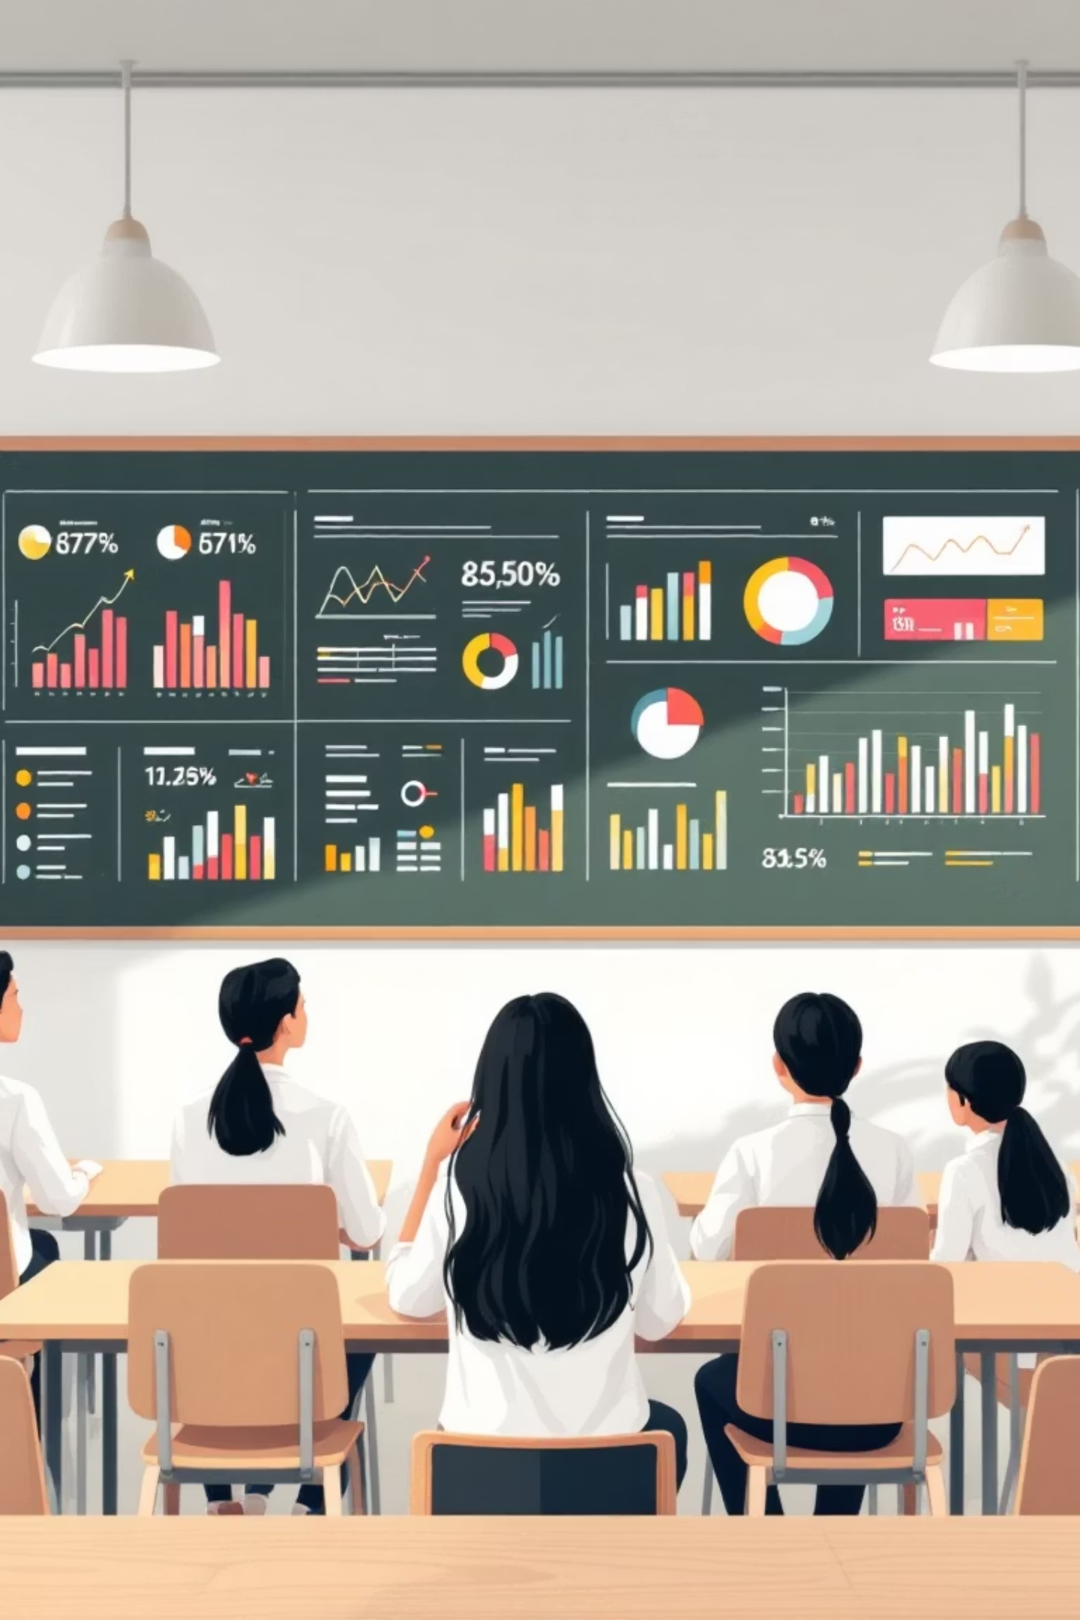
3D Environment :
A 3D environment is a computer-generated, three-dimensional digital space with depth and volume, allowing users to interact with virtual objects and simulated real-world scenarios.

Slide 11


1- A ball is an example of a sphere.

Slide 12
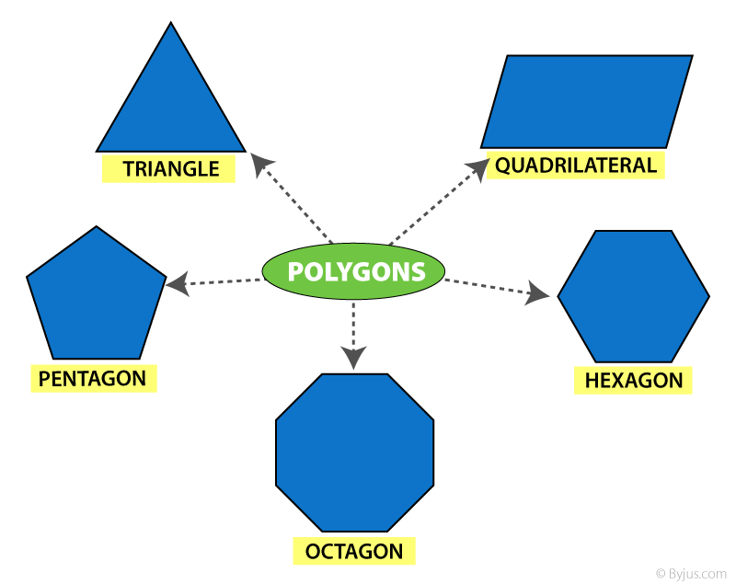
2- Plane geometry deals with flat shapes like lines, curve, polygons etc, which can be drawn on a piece of paper.

Slide 13

Exercise

Slide 14
Page Number 04

Slide 15
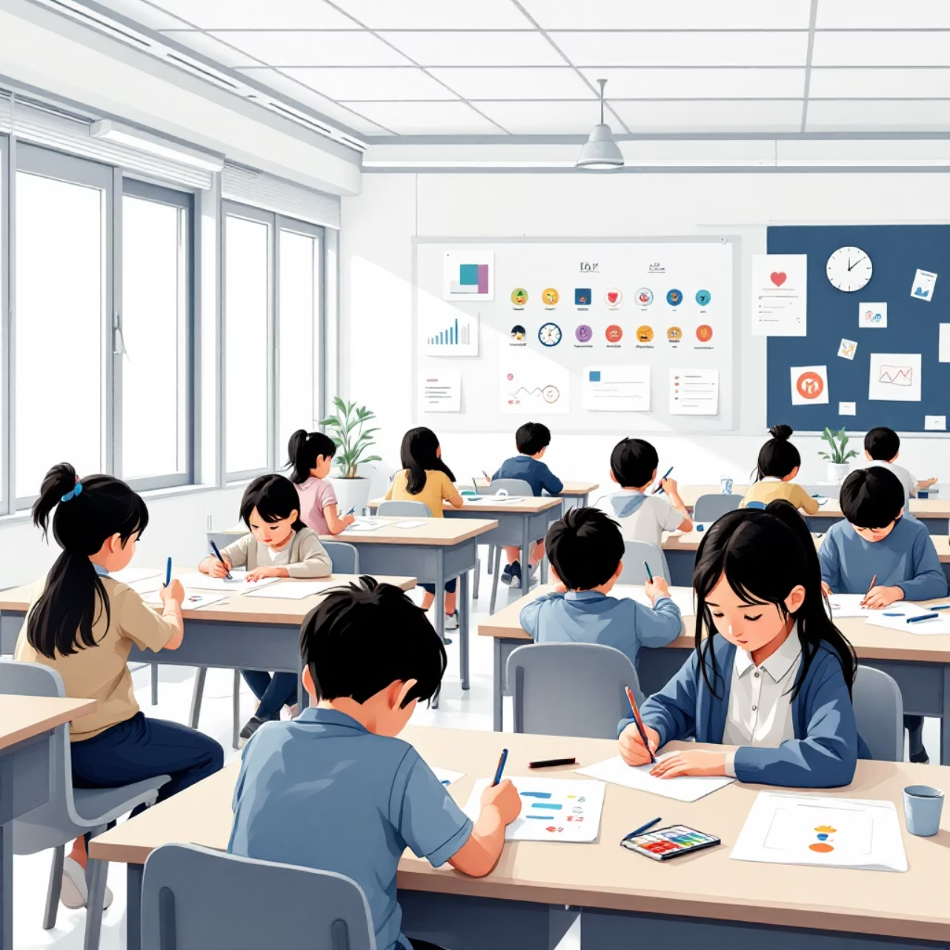
Are you ready to get started?

Slide 16
1- A ball is an example of a sphere.

Slide 17
1- A ball is an example of a sphere.
True

Slide 18
2- Plane geometry deals with flat shapes like lines, curve, polygons etc, which can be drawn on a piece of paper.

Slide 19
2- Plane geometry deals with flat shapes like lines, curve, polygons etc, that can be drawn on a piece of paper.
True

Slide 20


3- Blender is used to create animation movies.

Slide 21
3- Blender is used to create animation movies.
True

Slide 22





Homework

Slide 23
Page Number 11

Slide 24

Try to solve the questions by yourself, and if you can't, we'll solve them together in the next session

Slide 25

Do you have any other questions?

Slide 26
السلام عليكم
Thank you

